Slide 1

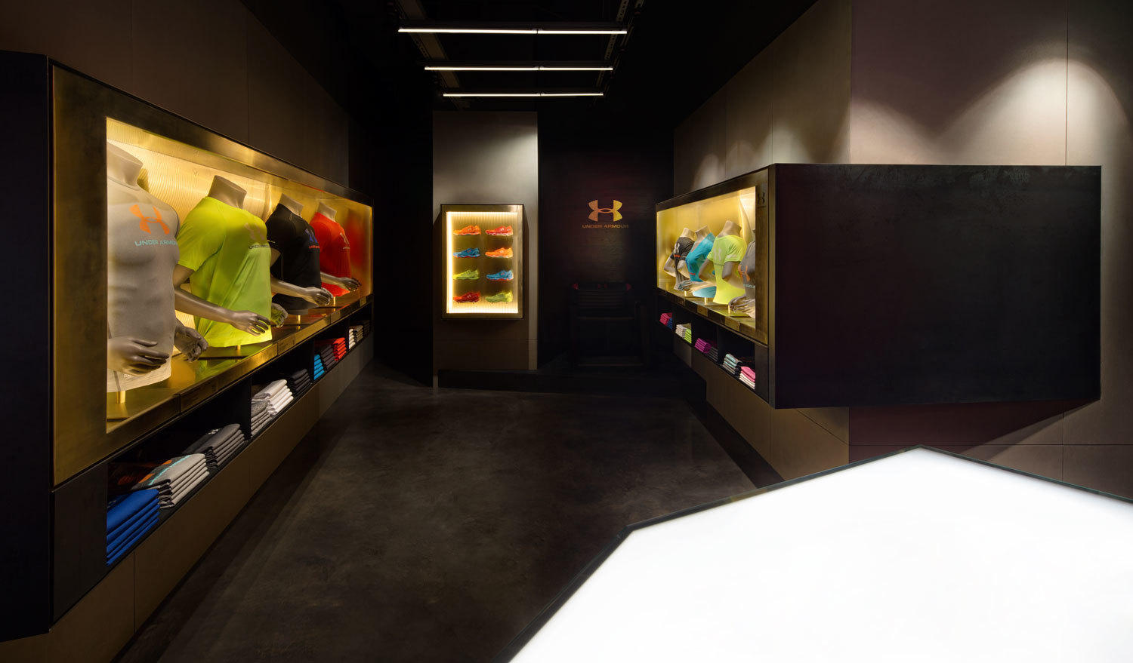
Diwali Sales Analysis
Python

Slide 2
Project Overview
In this project, I conducted a comprehensive analysis of Diwali sales data for a retail store. The analysis focused on examining sales patterns based on customer demographics and purchasing behaviors. Key areas of investigation included:
Gender-based Analysis: Evaluated sales data to identify spending patterns across different gender groups.
Occupation-based Spending: Analyzed the spending amounts relative to various customer occupations to determine high-value segments.
Product Category Analysis: Assessed sales performance across different product categories to identify top-selling items.
State-wise Sales: Conducted a geographical analysis to understand sales distribution across various states.
The insights derived from this analysis provided valuable recommendations for targeted marketing strategies and inventory optimization, ultimately enhancing the store's overall sales performance during the Diwali festive season.

Slide 3
Distribution of Customers based on Gender
Male – 3407
Female – 7832
Code: ax=sns.countplot(x='Gender',data=df)
for bars in ax.containers:
ax.bar_label(bars)
Insight – Female customers are prominet

Slide 4
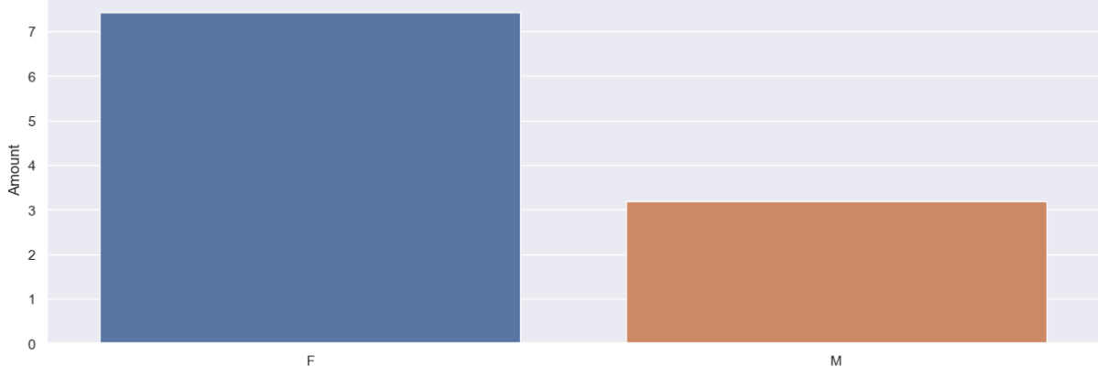
Sales Distribution Based on Gender
Code : ax=sns.barplot(x='Gender',y='Amount',data=sales_gen)
sns.set(rc={'figure.figsize':(15,15)})
Female Customers Spent More money than men

Slide 5
Customers Vs Age Group
Code : ax=sns.countplot(data=df,x='Age Group',hue='Gender’)
for bars in ax.containers:
ax.bar_label(bars)
Most of the customers are from age group 26-35
There are more Female customers of age group 26-35 then men
Female - 3269
Men - 1272

Slide 6
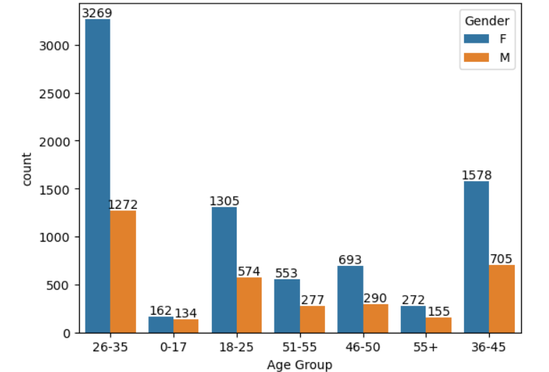
Customer Vs Age Group

Slide 7
Sales Vs Age Group
Code :
sales_age=df.groupby(
['Age Group'],as_index=False)['Amount'].sum().sort_values(by='Amount',ascending=False)
sns.barplot(data=sales_age,x='Age Group',y='Amount’)
Insights : Customers of Age Group 26-35 Spent the most

Slide 8
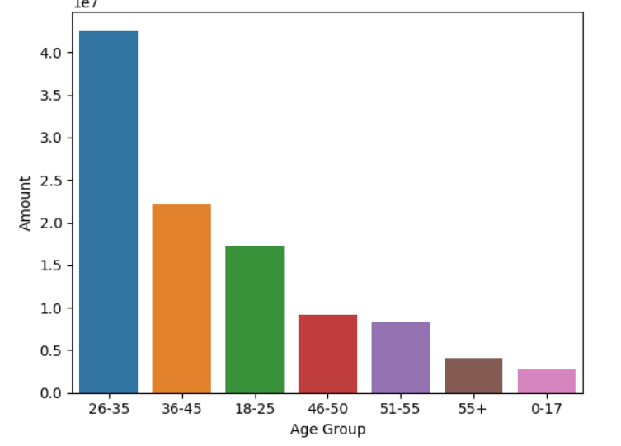
Sales Vs Age Group

Slide 9
No of Orders Vs State
Code :
sales_state=df.groupby(
['State’], as_index=False)['Orders'].sum().sort_values(by='Orders',ascending=False).head(10)
sns.set(rc={'figure.figsize':(15,5)})
sns.barplot(data=sales_state,x='State',y='Orders’)
Insight : Uttar Pradesh is the state with highest no of orders

Slide 10
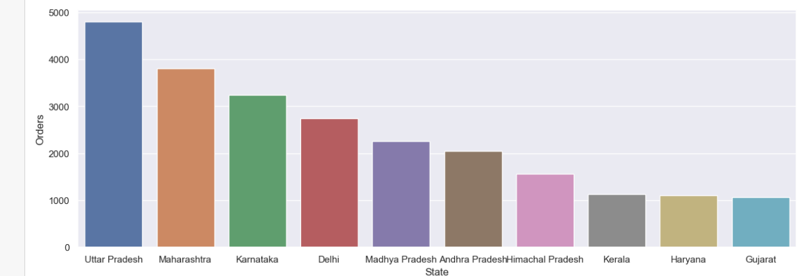
No of Orders Vs State

Slide 11
Sales Vs State
Code:
sales_state=df.groupby(
['State'],as_index=False)['Amount'].sum().sort_values(by='Amount',ascending=False).head(10)
sns.set(rc={'figure.figsize':(15,5)})
sns.barplot(data=sales_state,x='State',y='Amount’)
Uttar Pradest is the state with highest sales.

Slide 12
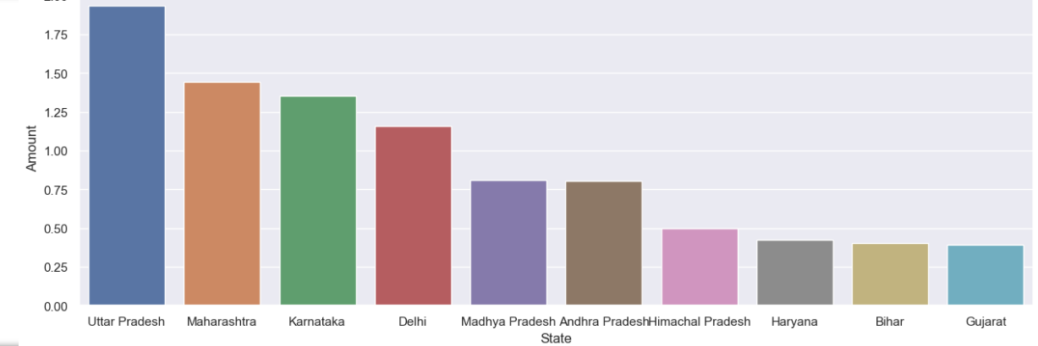
Sales Vs State

Slide 13
Customers And their Maritial Status
Code:
ax=sns.countplot(data=df,x='Marital_Status’)
sns.set(rc={'figure.figsize':(7,5)})
for bars in ax.containers:
ax.bar_label(bars)
Insights : There are more Married Customers than UnMarried
Married – 6518
UnMarried - 4721

Slide 14
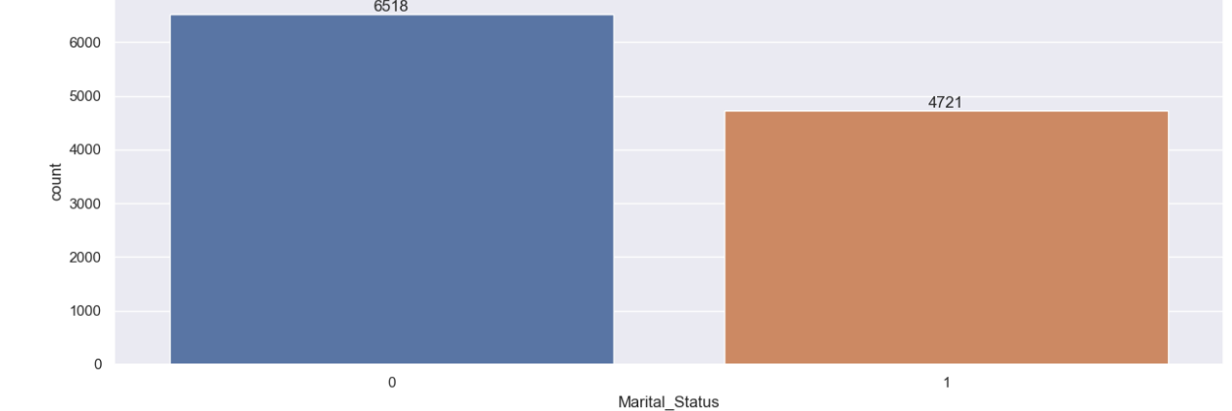
Customer And Their Marritial Status

Slide 15
Customer And Their Maritial Status Based On Gender
Code :
sales_maritalStatus=df.groupby(['Marital_Status','Gender'],as_index=False)['Amount'].sum()
ax=sns.barplot(data=sales_maritalStatus,x='Marital_Status',y='Amount',hue='Gender')
sns.set(rc={'figure.figsize’:(7,5)})
Insights : Married Women Spent the most amount of Money

Slide 16
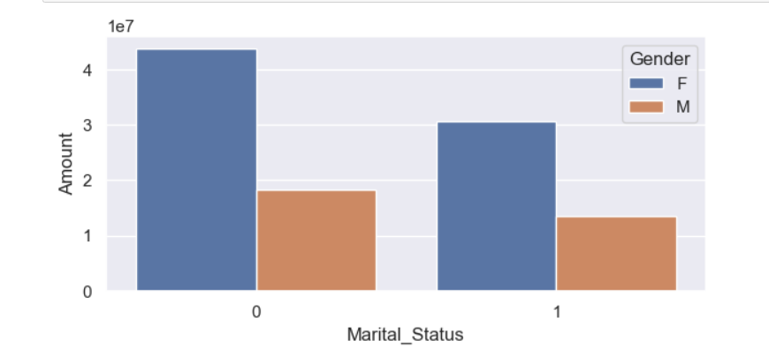
Customer And Their Maritial Status Based On Gender

Slide 17
Customer And Their Occupation
Code :
sns.set(rc={'figure.figsize':(20,5)})
ax=sns.countplot(data=df,x='Occupation’)
for bars in ax.containers:
ax.bar_label(bars)
Insights : Most of the customers are from IT Sector And Healthcare.

Slide 18
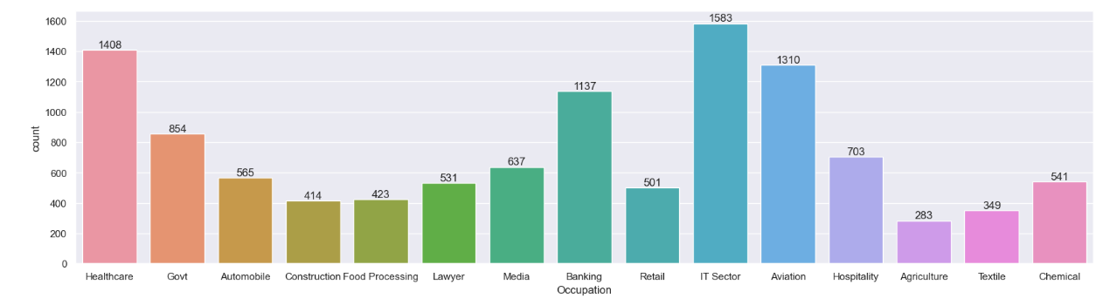
Customers And Their Occupation

Slide 19
Sales vs Product Category
Code :
sales_category=df.groupby(['Product_Category'],as_index=False)['Amount'].sum().sort_values(by='Amount',ascending=False).head(10)
sns.barplot(data=sales_category,x='Product_Category',y='Amount')
sns.set(rc={'figure.figsize':(15,15)})
Insights : Food Category is prominent amongst other.

Slide 20
Most Selling Product
Code :
sales_state=df.groupby(['Product_ID'],as_index=False)['Orders'].sum().sort_values(by='Orders',ascending=False).head(10)
sns.set(rc={'figure.figsize':(20,5)})
sns.barplot(data=sales_state,x='Product_ID',y='Orders’)
Insights : Product of Order Id(P00265242) is the most selling product.

Slide 21
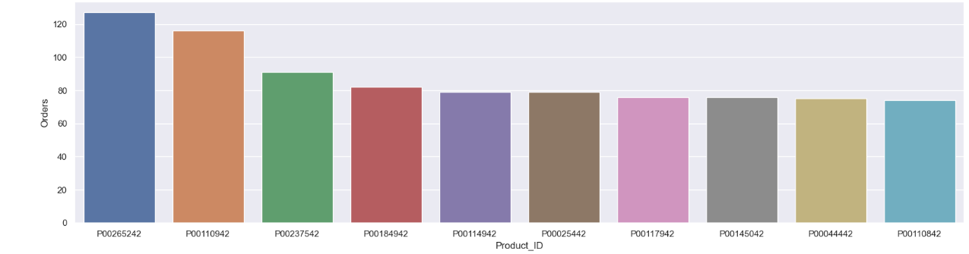
Most Selling Product

Slide 22
ThankYou

